Slide 1
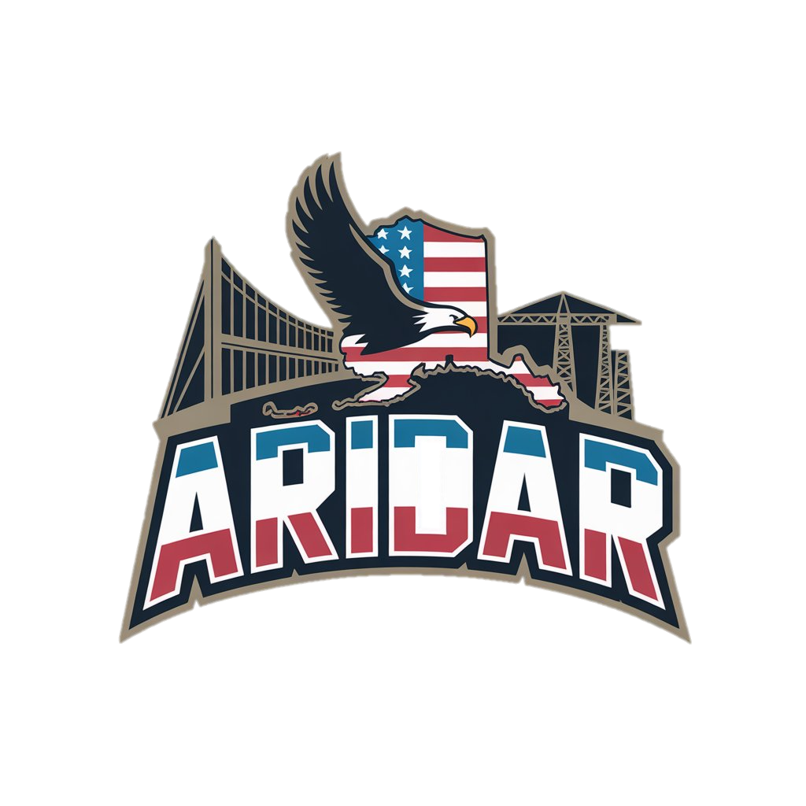
Alaska Infrastructure & Defense Readiness
A Coordinated Strategy to Strengthen Alaska’s Federal Position
Jason Hoke, Executive Director
Copper Valley Development Association
ARDOR
March 10, 2026
Notes:
I want to use today to share something we’re building, not a funding ask, not a bill, but a coordination tool that strengthens Alaska’s hand in D.C.

Slide 2
The Strategic Moment
Arctic security is escalating
Federal defense investment is accelerating
Alaska hosts Tier One facilities
Infrastructure readiness will determine funding velocity and military preparedness
Notes:
Is Alaska is presenting itself as coordinated and ready to absorb that investment efficiently?
Federal dollars do not just follow need. They follow readiness.

Slide 3

The Core Problem
No unified, defense-aligned narrative
Regions have projects
ARDORs know the priorities
Utilities have needs
Federal staff do not have time to piece this together
Notes:
From a federal staff perspective, it’s fragmented.
There isn’t one concise, defense-aligned narrative that connects infrastructure to national security outcomes. No need to reinvent the wheel.
That gap is what we’re solving.

Slide 4


ARIDAR Is A Focused Readiness Tool
ARIDAR IS:
A concise, 1–2 page federal-ready white paper
A coordinated synthesis of ARDOR infrastructure priorities
Focused on ALL Infrastructure Pillars
Linked to a structured digital companion
ARIDAR IS NOT:
A new planning exercise
A long technical report
A political messaging document
Notes:
We are synthesizing what already exists into a tight, 1–2 page white paper aligned with Department of Defense objectives.
Short. Strategic. Actionable.
This is a FOCUSED READINESS TOOL

Slide 5

Keep It Simple, Smartie
Federal decision-makers need:
Clarity
Confidence
Speed
The white paper is the front door.
The website is the library.
Image Source: airport-technology.com
Notes:
Federal staffers do not have time to sift through a report full of recommendations. A short 1-2 page document will get read and get noticed. Getting eyes on our prioritized list of shovel-ready, FUNDING-READY projects.

Slide 6

The Digital Companion
If asked: “How much? Where? What phase?”
Scan a QR code to access:
Prioritized infrastructure list
Costs
Phasing
Regional breakdown
aridar.org
Notes:
We want Alaska to look organized and investment-ready.

Slide 7
Why This Strengthens Alaska’s Position
Demonstrates ARDOR coordination
Shows cost awareness
Connects infrastructure to defense outcomes
Reduces perceived risk for federal investment
Defense Readiness Needs
Federal dollars follow organization and coordination
Notes:
When Washington sees organization and COORDINATION, funding moves faster.

Slide 8

Guardrails & Discipline
1–2-page white paper
Defined website scope
Structured deliverables
Clear path for federal dollars to flow
Clear scope = controlled cost and timeline
Notes:
We are not opening a sprawling project. This is a focused readiness tool.

Slide 9



What We Need From You
Strategic alignment on messaging
Reinforcement in federal conversations
Awareness of coordinated ARDOR effort
Early champions
A seat at the table and part of the planning discussion.
No funding ask today. We need alignment and awareness.
Notes:
We are not asking for funding today.
We are asking for alignment and support.
Your feedback matters as this narrative develops. When you are in critical conversations, this gives you a shared framework to reference.

Slide 10

What Success Looks Like
Federal staff reference Alaska’s coordinated infrastructure plan
Alaska is seen as investment-ready
Projects move faster through state channels
State-federal communication tightens
Notes:
Ultimately, more and faster funding flowing to projects WE need

Slide 11
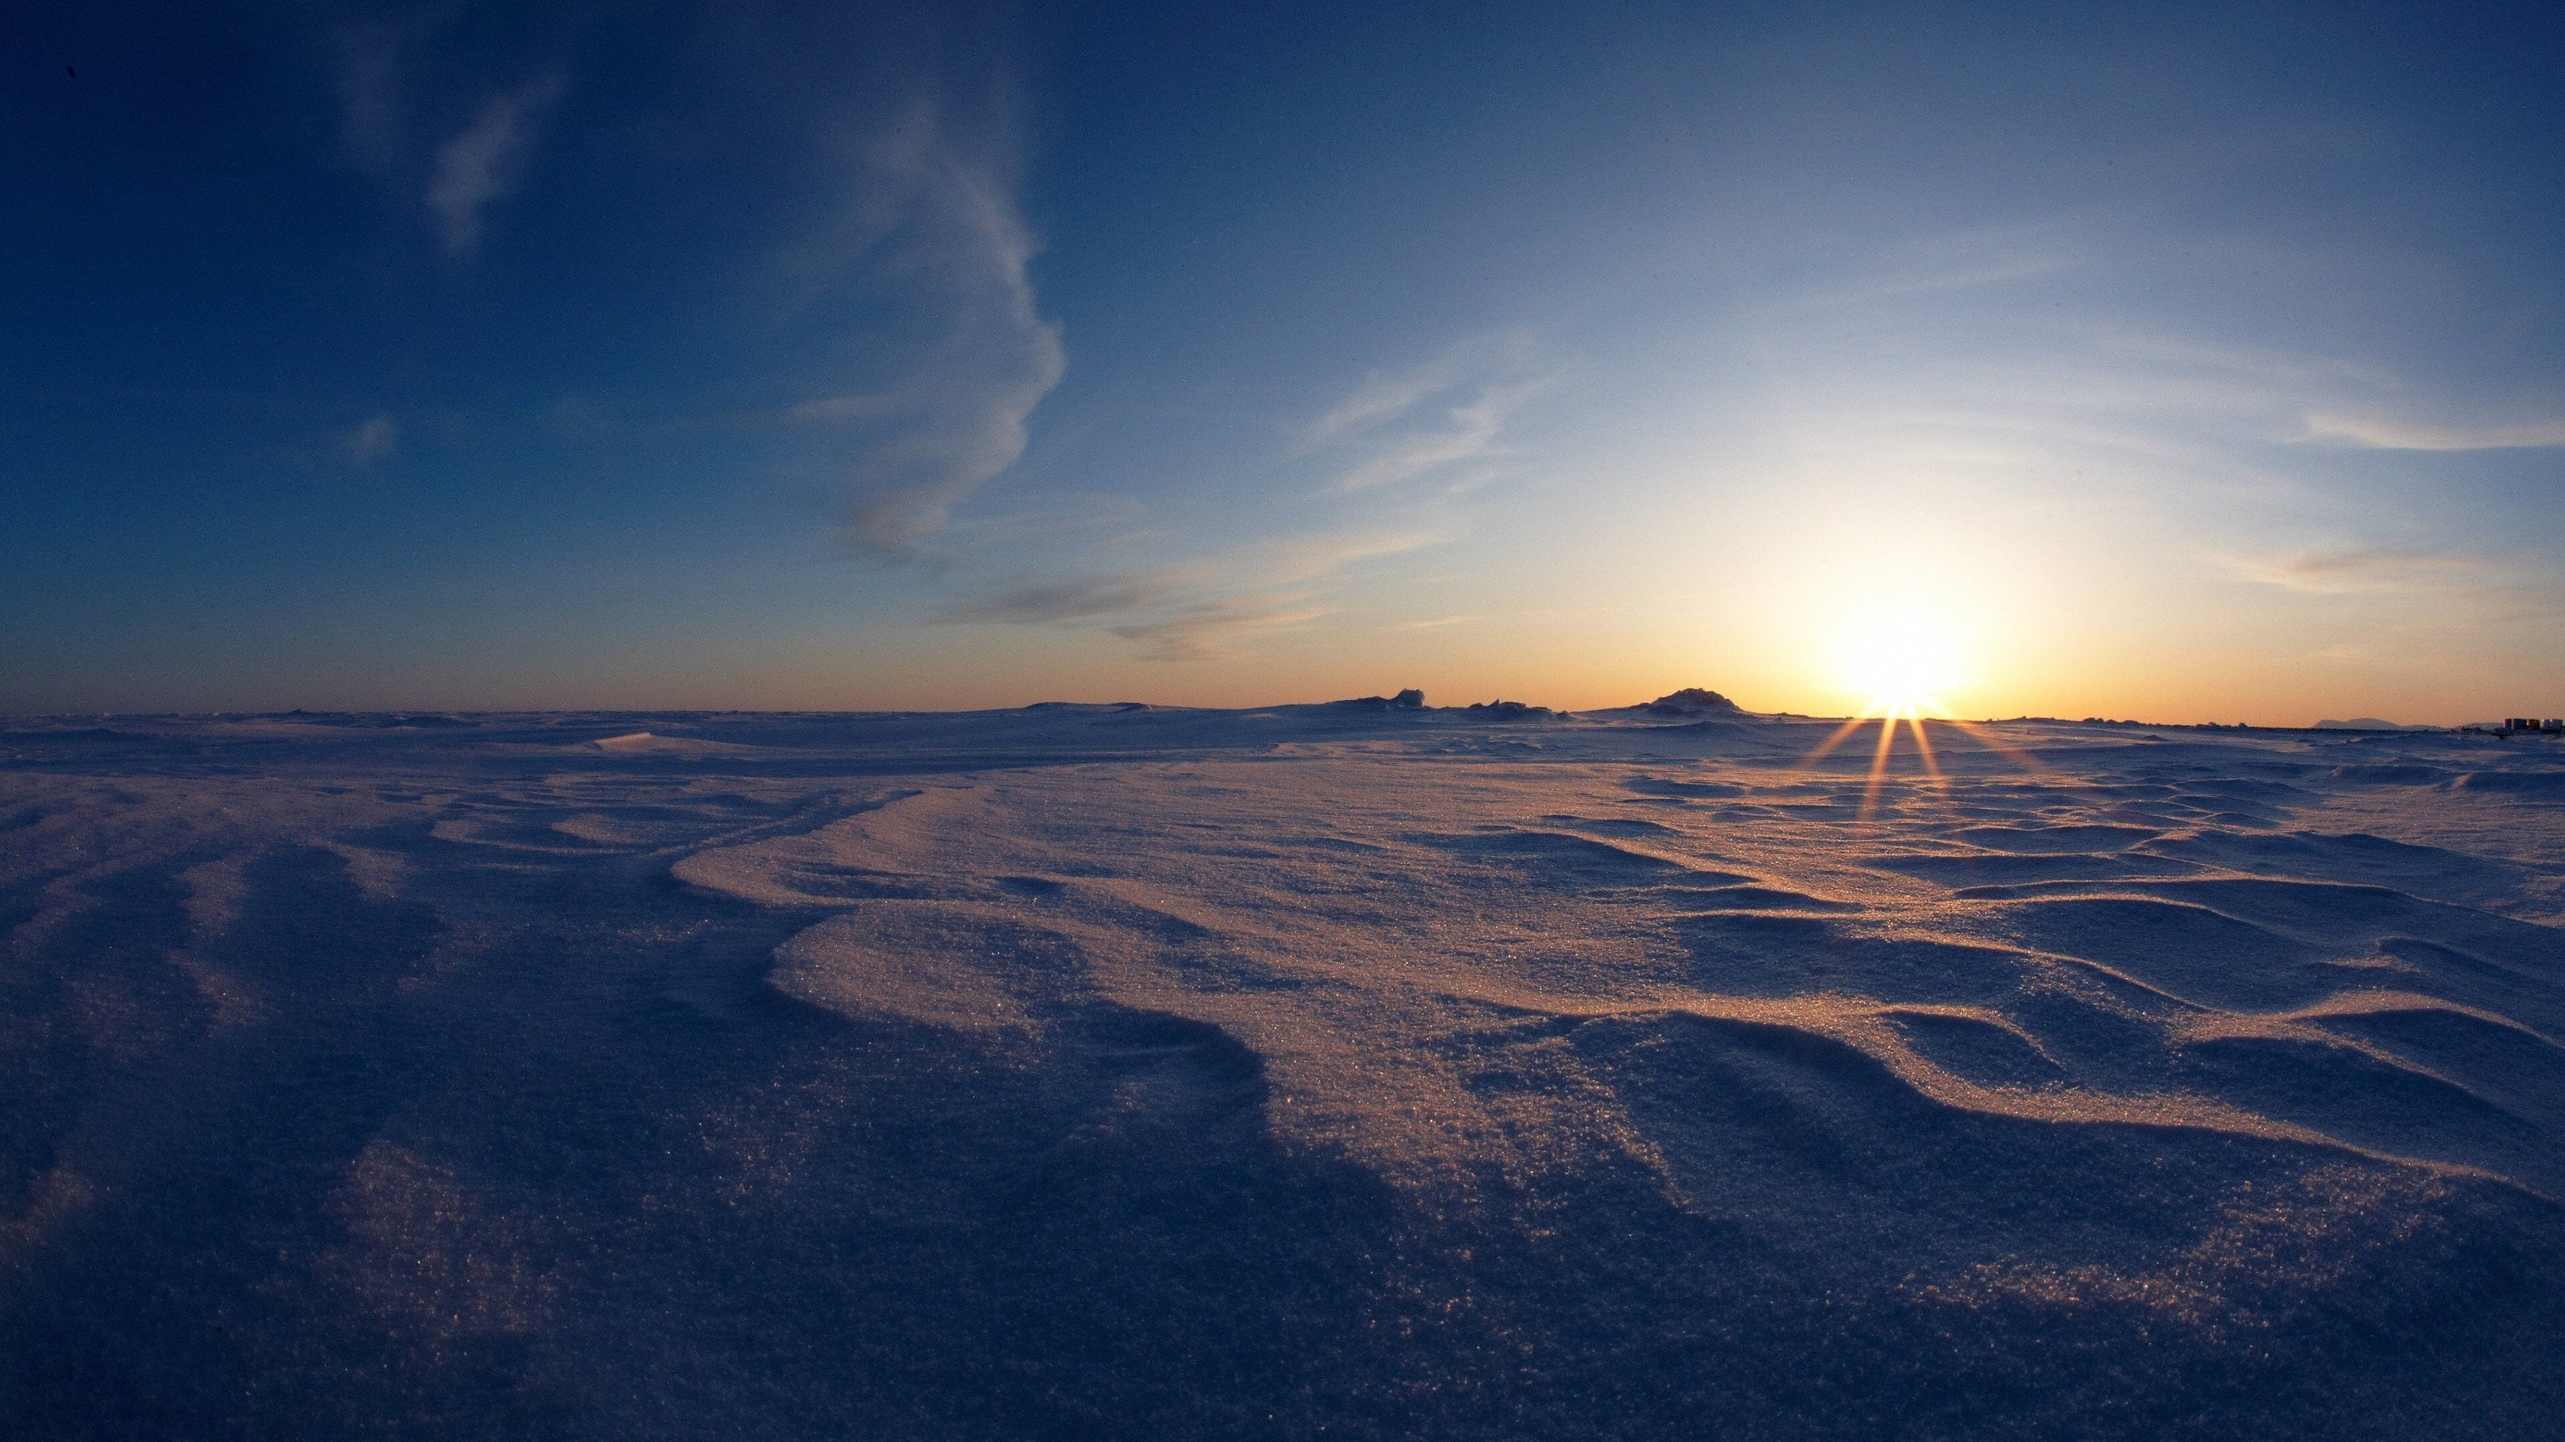

Alaska’s geography is strategic.
Our infrastructure must be equally strategic.
Prepared by Economic Development Consultants
For more information scan here or email jhoke@coppervalley.org
Image Source: AARP
Notes:
This initiative ensures our messaging matches our reality.

